Slide 1
Event Lens
Guided By,
Dr. N.Umakanth, AP(Sl.Gr.)
Dr. K,Muthamizh Sudar, AP(Sr.Gr.)
Department of CSE
Pothiraju P V – 9517202304112
Suriya Pandian – 9517202304156
Mallesh Kumar – 9517202304254

Slide 2
AGENDA
Problem Statement
Objective
Outcome
System Design
UML Diagrams
Implementation Results / Screenshots
Platform and Languages
References
Demo

Slide 3
Problem Statement
There is a lack of an effective online platform where users can easily discover, verify, and book photographers for events, while ensuring the originality of showcased images. Existing solutions often fail to provide an engaging image-based discovery experience and do not adequately protect photographers' works from plagiarism. This project aims to create a website that offers a social media-like feed for exploring photographers’ portfolios, integrates digital imaging techniques to verify image authenticity, and streamlines the booking process to connect clients with professional photographers securely and efficiently.

Slide 4
Abstract
This project introduces an innovative photographer hiring website that allows users to seamlessly discover and book professional photographers for their events through an interactive, social media-inspired image feed. Users can browse authentic portfolios, compare photographers based on style, availability, and reviews, and make informed booking decisions directly through the platform. To ensure the originality and integrity of all showcased images, advanced digital imaging techniques such as metadata analysis and image fingerprinting are employed, effectively protecting photographers’ work from plagiarism and assuring clients of genuine content. This solution aims to bridge the gap between clients and photographers, creating a trustworthy, engaging, and secure environment for event photography services.

Slide 5
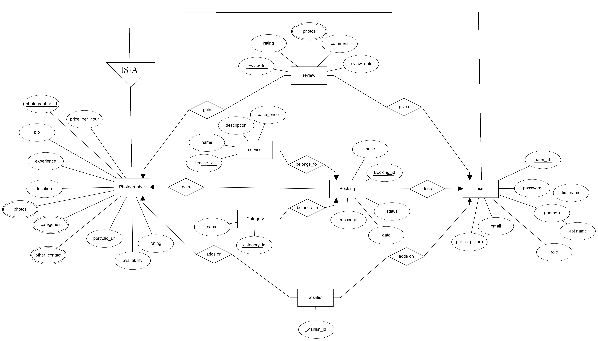
ER Diagram

Slide 6
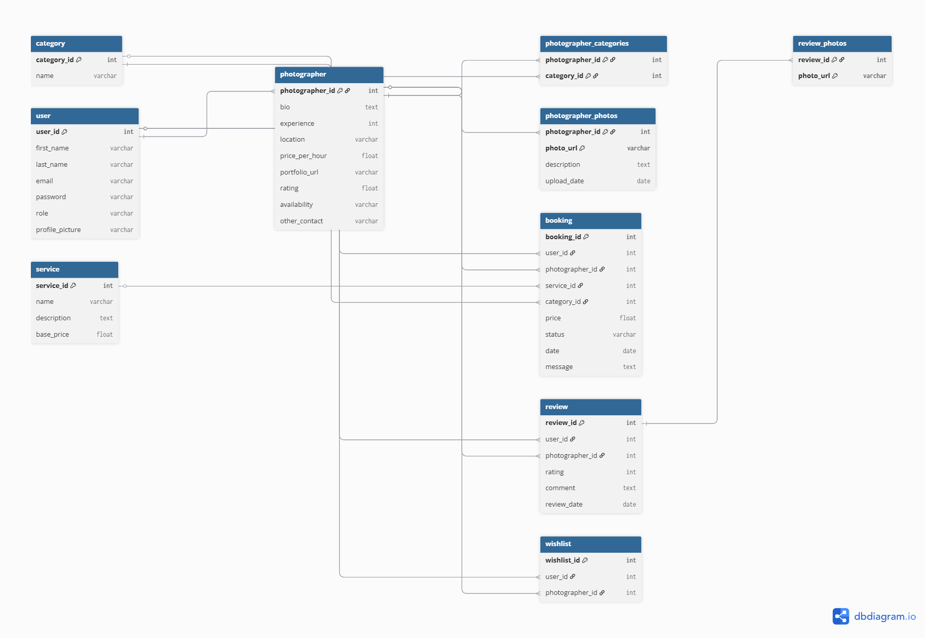
Schema Diagram

Slide 7
Platforms and Languages
Platform :
Frontend: WixStudio
Backend: Microsoft Azure (Authentication, SQL Database, Server)
Languages :
Frontend - HTML, CSS, JavaScript
Backend - PostgreSQL by Azure
Services :
Authentication - Azure
Environment :
VS Code - Web Development Extensions for development.
Azure Dashboard: For managing your backend services.

Slide 8
References
https://docs.microsoft.com/en-us/azure/
https://developer.mozilla.org/en-US/docs/Web
https://www.postgresql.org/docs/
Digital Image Forgery Detection: A Survey. Farid, H. (2009). IEEE Signal Processing Magazine, 26(2), 16-25. (For digital imaging and image originality verification.)

Slide 9
Thank You…

